Slide 1

Amazon e-Retail Case Study
ETL process USING SSIS
Report building USING SSRS
Visualization using Tableau
Building Graphical and Sql databases using ryan School Dataset

Slide 2
Objectives
Total expenditure w.r.t. categories among Customers yearly
Order Status w.r.t. departments among Customers yearly
Total orders and price per Category w.r.t. Cities yearly
Order status w.r.t. cities per day yearly

Slide 3
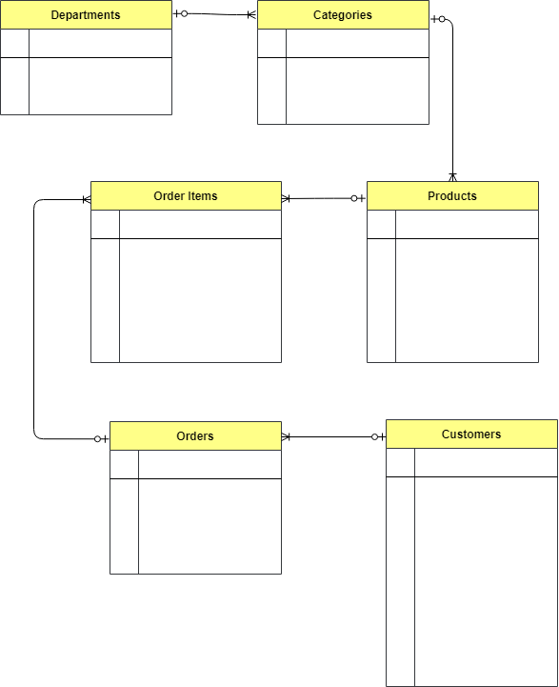
Amazon retail dataset
Customer Details
Product Details
Order Details
Order Item Details
Category
Department

Slide 4
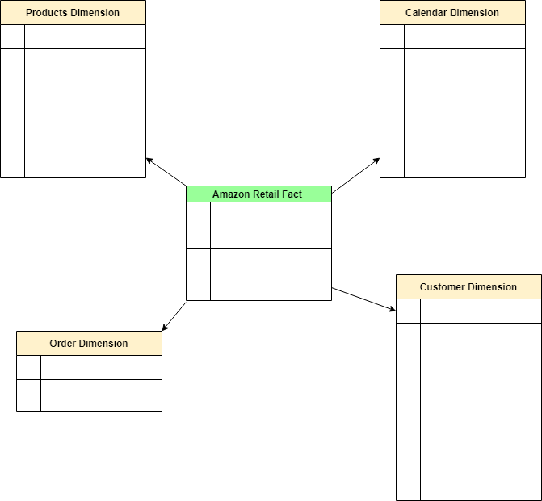
Dimensional Modelling-Star Schema

Slide 5
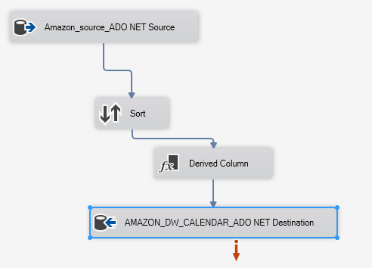
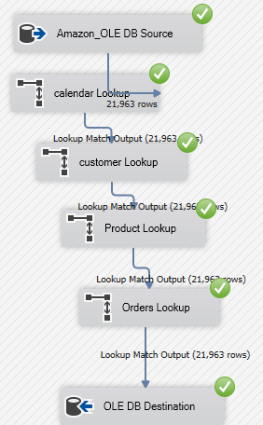
ETL via SSIS in Visual Studio

Slide 6
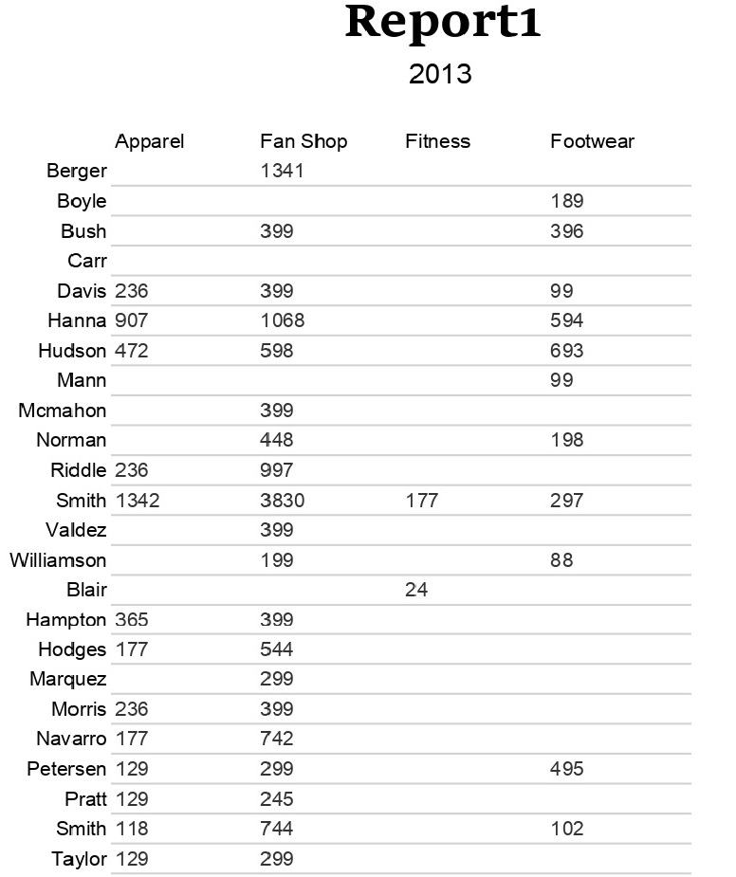
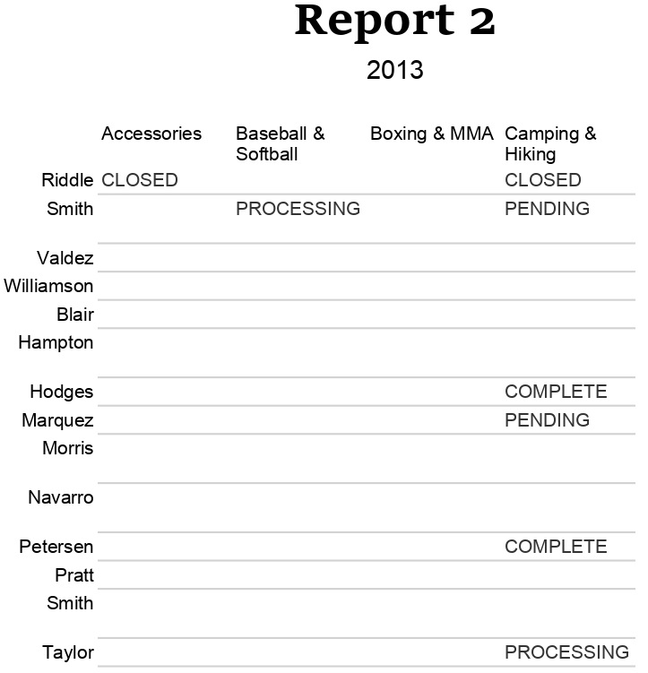
Report Generation with SSRS in Visual Studio

Slide 7
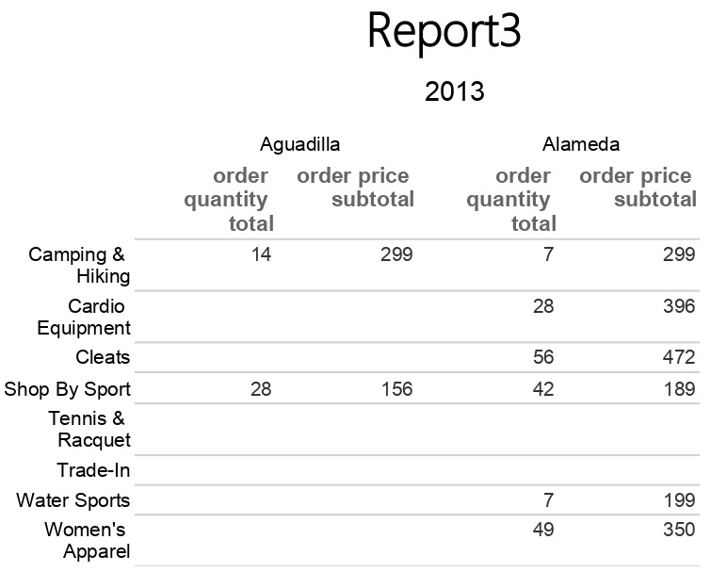
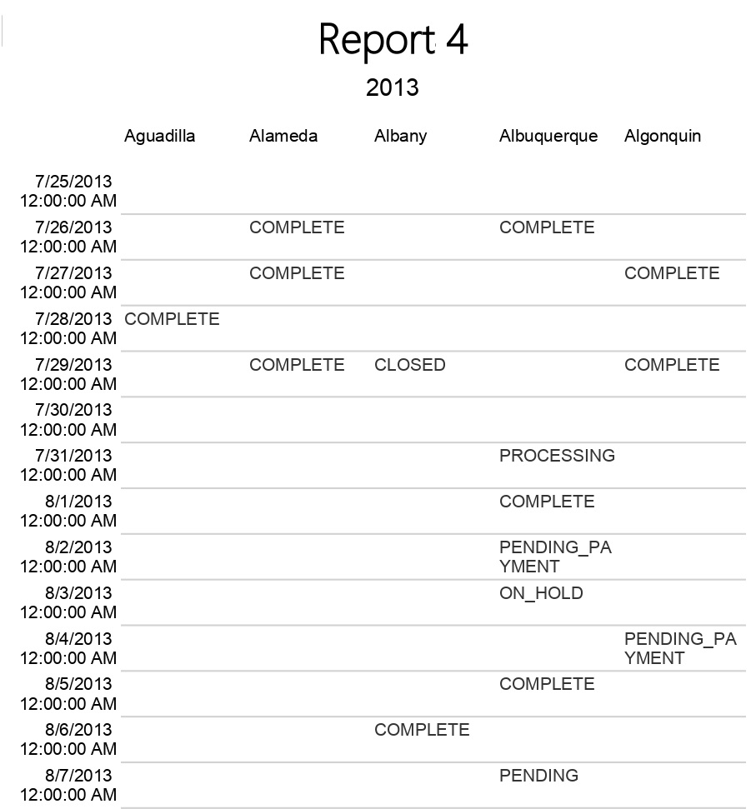

Slide 8
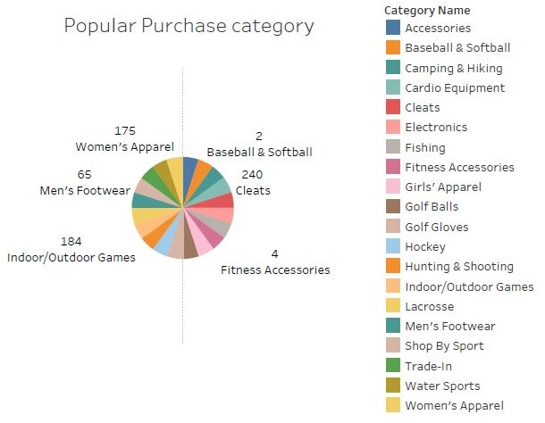
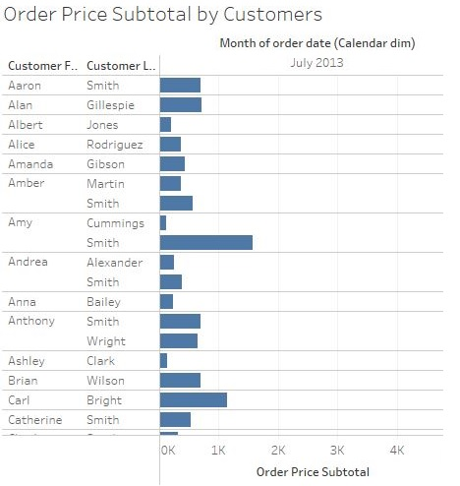
Visualization of Data using Tableau

Slide 9
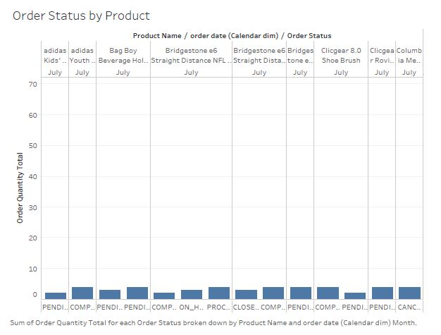
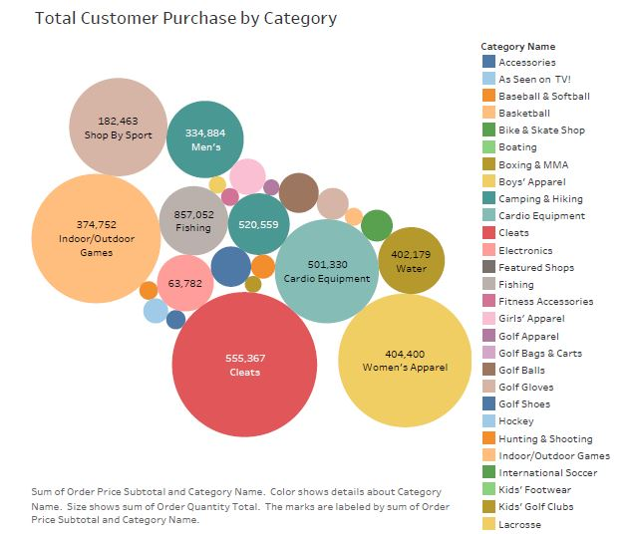

Slide 10
Ryan School Dataset
Overview of Graph Database with Neo4j
Graph Database MODEL
Deployment of Graph Database using Neo4j
Relational database
Neo4j vs SQL comparison

Slide 11
Overview of Graph Database with Neo4j
No pre-defined model
Properties
-- Intuitiveness
-- Speed
-- Agility
Data organization
-- Nodes
-- Relationships
-- Properties

Slide 12
Graph Database Model
Onsite Course
Course Instructor
Person
offerscourse
Teaches
Enrolled
Online Course
Student Grade
Course
Enrolled
offerscourse
Enrolled
department
Department
Office Assignment

Slide 13
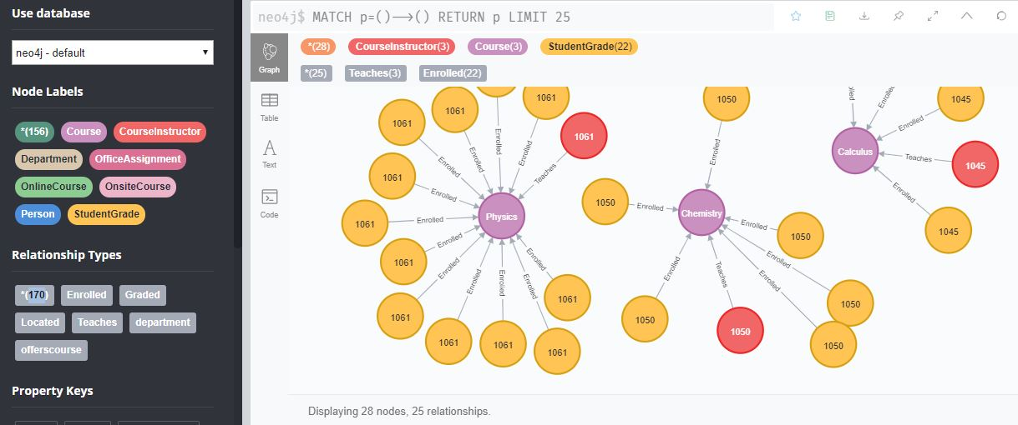
Deployment of Graph Database using Neo4j
Loading CSV file
Creating Constraint
Building relations
or Creating labels

Slide 14
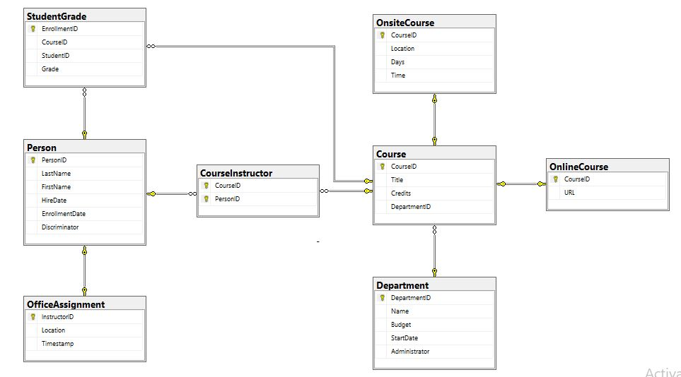
Relational Database Schema

Slide 15
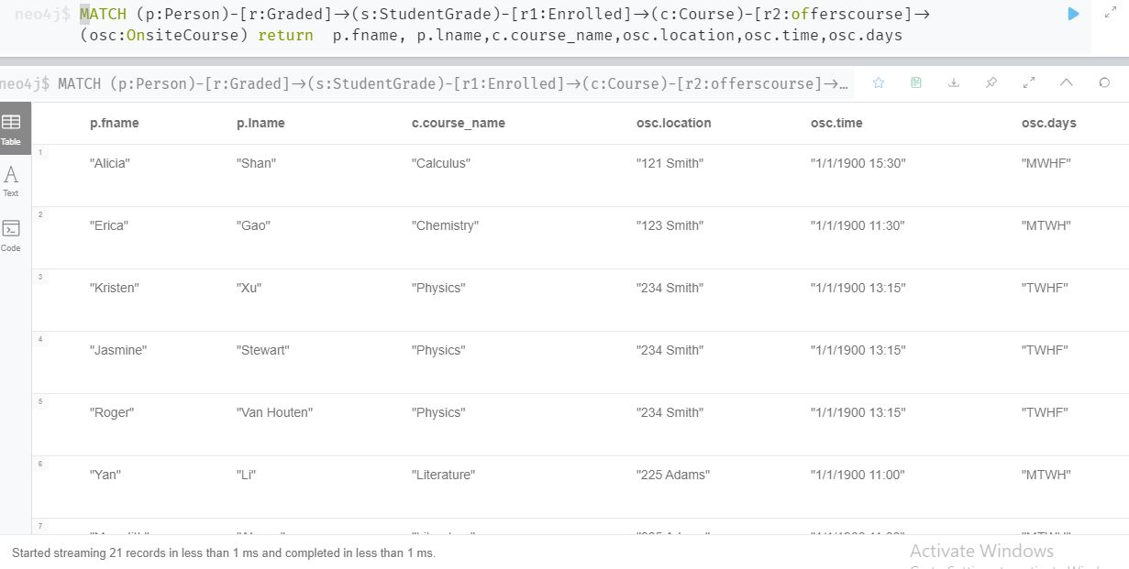
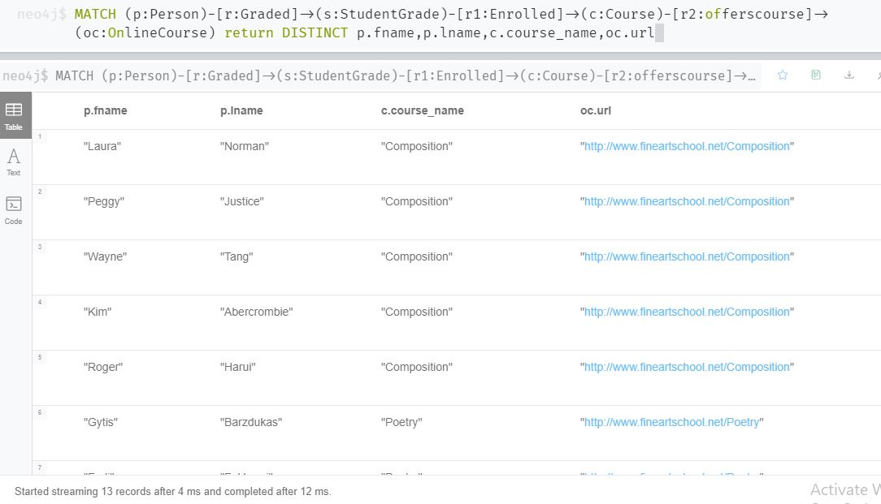
Querying Graph Database
Students School Time Table :-
URL for Online Classes for Students enrolled:-

Slide 16
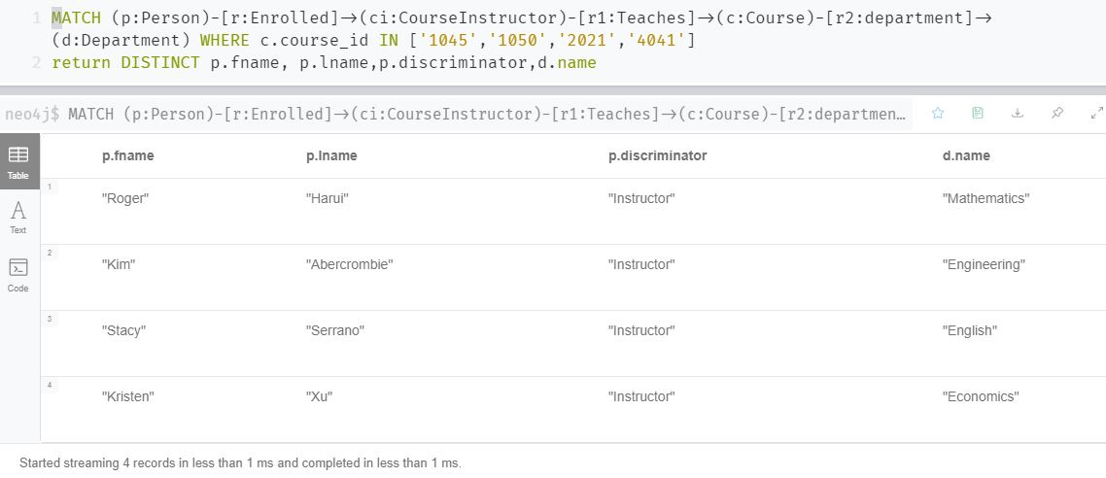
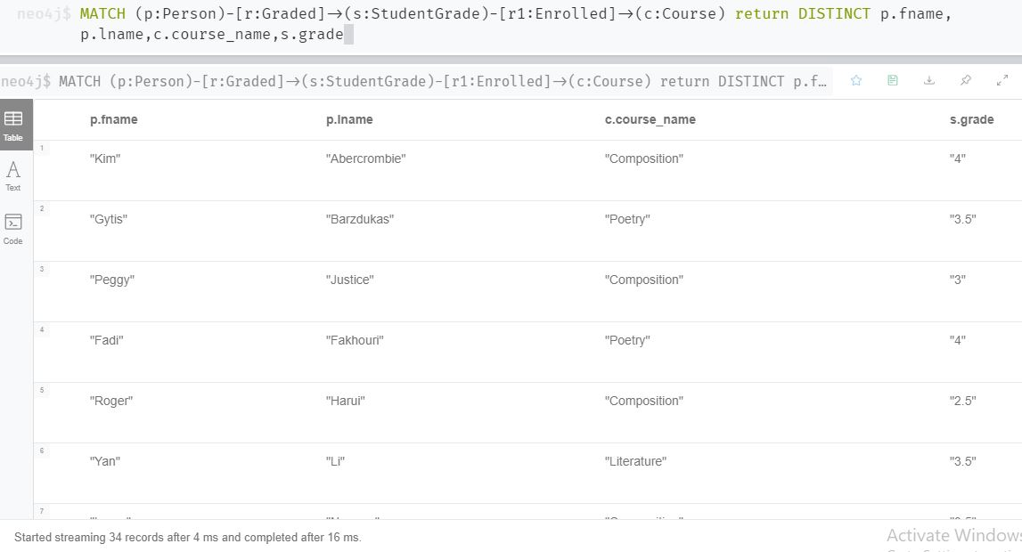
Use set of Course Id values to fetch Instructor/Student
names and their respective Departments:-
Use set of Course Id values to fetch Instructor/Student
names and their respective Departments:-

Slide 17
Neo4j vs SQL Comparison
Query performance challenges
Ease of understanding and Maintenance
Query run time
Ease of Database modelling

Slide 18
Thank You!

